Slide 1
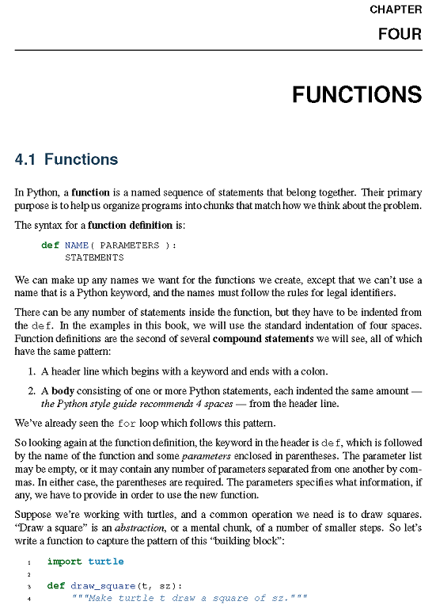

Slide 2
import turtle
def draw_square(t, sz):
'''Make turtle t draw a square of sz.'''
for i in range(4):
t.forward(sz)
t.left(90)
wn = turtle.Screen() # Set up the window and its attributes
wn.bgcolor("lightgreen")
wn.title("Alex meets a function")
alex = turtle.Turtle() # Create alex
draw_square(alex, 50) # Call the function to draw the square
wn.mainloop()

Slide 3

************************************************
WS ch4_1
Write a function, draw_triangle(t,sz), which draws an equilateral triangle of size sz using Turtle t.
*************************************************
draw_triangle(tess,150)

Slide 4
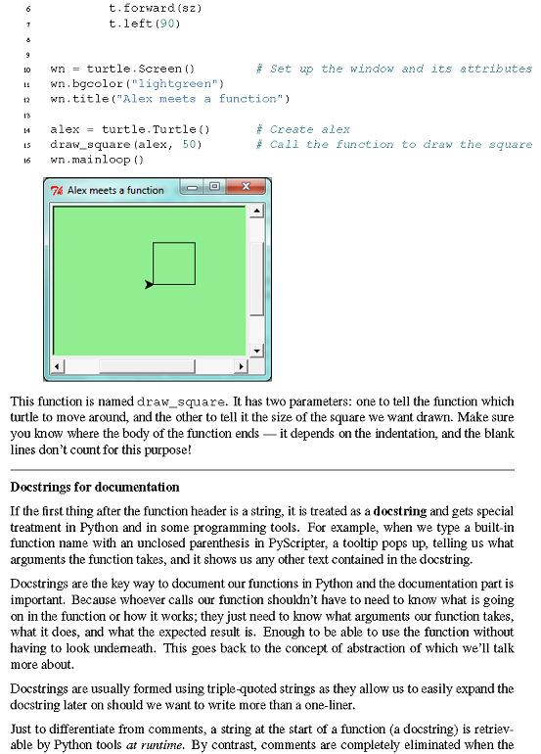

Slide 5
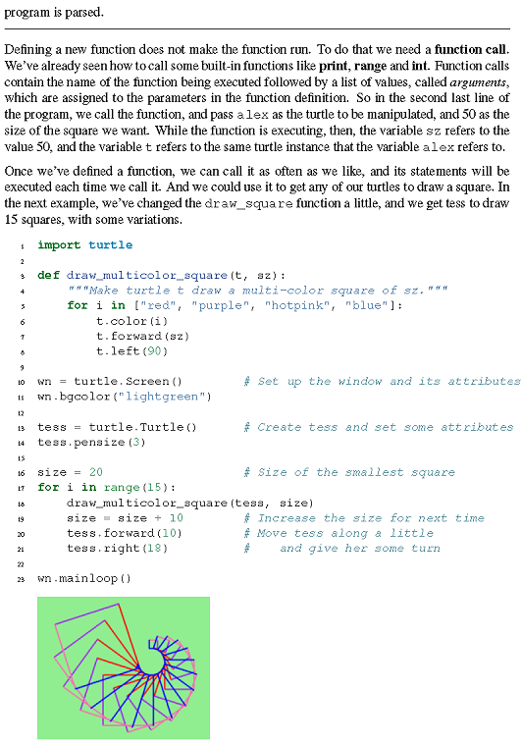

Slide 6
import turtle
def draw_multicolor_square(t, sz):
"""Make turtle t draw a multi-color square of sz."""
for i in ["red", "purple", "hotpink", "blue"]:
t.color(i)
t.forward(sz)
t.left(90)
wn = turtle.Screen() # Set up the window and its attributes
wn.bgcolor("lightgreen")
tess = turtle.Turtle() # Create tess and set some attributes
tess.pensize(3)
size = 20 # Size of the smallest square
for i in range(15):
draw_multicolor_square(tess, size)
size = size + 10 # Increase the size for next time
tess.forward(10) # Move tess along a little
tess.right(18) # and give her some turn
wn.mainloop()

Slide 7
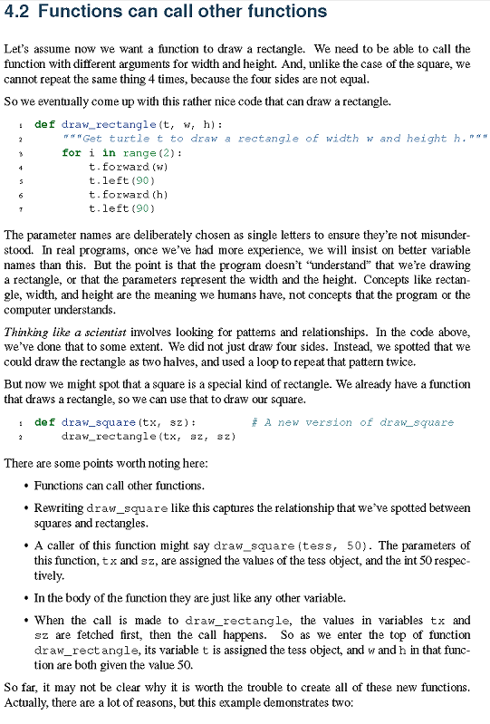

Slide 8
import turtle
def draw_rectangle(t, w, h):
"""Get turtle t to draw a rectangle of width w and height h."""
for i in range(2):
t.forward(w)
t.left(90)
t.forward(h)
t.left(90)
wn = turtle.Screen() # Set up the window and its attributes
wn.bgcolor("lightgreen")
tess = turtle.Turtle() # Create tess and set some attributes
tess.pensize(3)
draw_rectangle(tess,200,100)

Slide 9

**************************************************
WS ch4_2
Write a function, draw_rects(t,W1,H1,W2,H2), which uses Turtle t to draw 2 rectangles with the same center. Can you use draw_rectangle(t,W,H) as a helper function? Can you write any other useful helper functions?
**************************************************
draw_rects(tess,200,20,25,400)

Slide 10
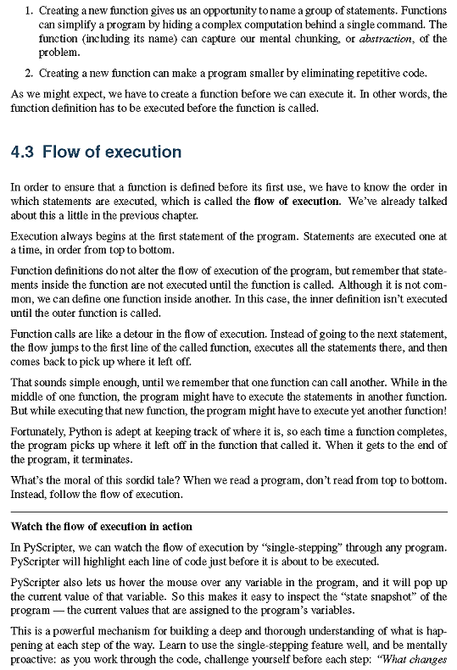

Slide 11
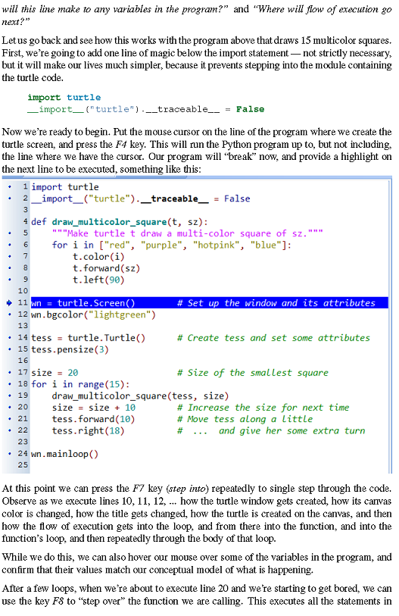

Slide 12
import turtle
__import__("turtle").__traceable__ = False

Slide 13
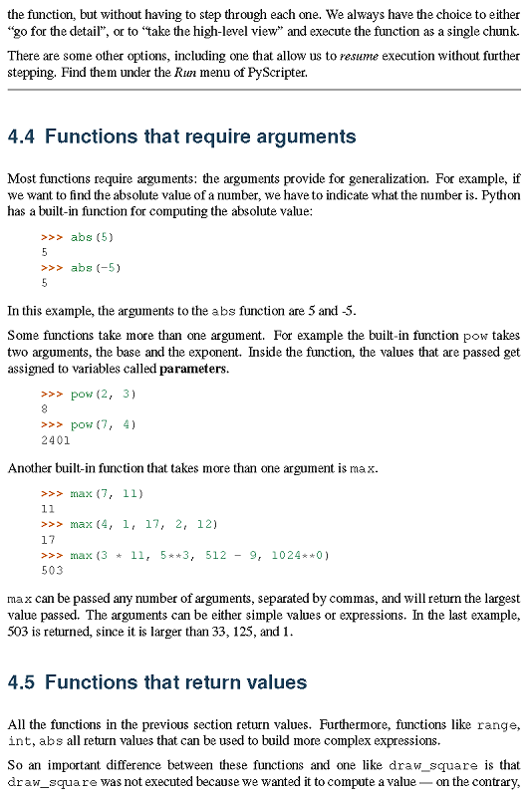

Slide 14
>>> abs(5)
5
>>> abs(-5)
5
>>> pow(2, 3)
8
>>> pow(7, 4)
2401
>>> max(7, 11)
11
>>> max(4, 1, 17, 2, 12)
17
>>> max(3 * 11, 5**3, 512 - 9, 1024**0)
503

Slide 15
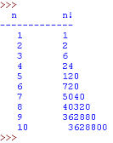
*********************************************
WS ch4_3
Write a function, five_factorial(), which return 5! = 1*2*3*4*5
********************************************
***********************************************
WS ch4_4
Write a function, factorial(n), which returns n! . n is an int >=1.
***********************************************
*************************************************
WS ch 4_5
Use factorial(n) to print out a table of n! for 1 <= n <= 10.
************************************************

Slide 16
*************************************************
WS ch 4_5A
Write a function, f2c(fahr), that takes degrees in Fahrenheit & returns Celsius degrees.
Write a function, f2k(fahr), that takes Fahrenheit degrees & returns Kelvin degrees. Use f2c(fahr) as a helper function.
32F ~ 0C, 212F ~ 100C
deg K = deg C + 273.15
************************************************

Slide 17
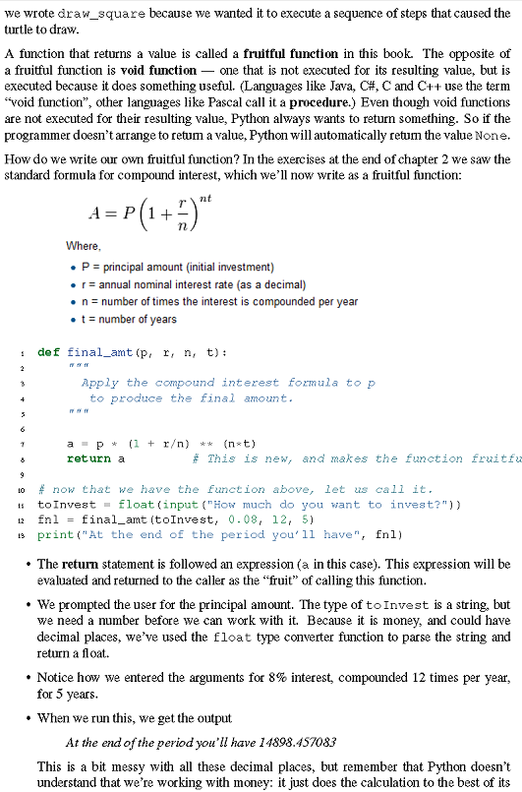

Slide 18
def final_amt(p, r, n, t):
"""
Apply the compound interest formula to p
to produce the final amount.
"""
a = p * (1 + r/n) ** (n*t)
return a # This is new, and makes the function fruitful.
# now that we have the function above, let us call it.
toInvest = float(input("How much do you want to invest?"))
fnl = final_amt(toInvest, 0.08, 12, 5)
print("At the end of the period you’ll have", fnl)
##>>>
##How much do you want to invest?1000
##At the end of the period you’ll have 1489.845708301605
##>>>

Slide 19
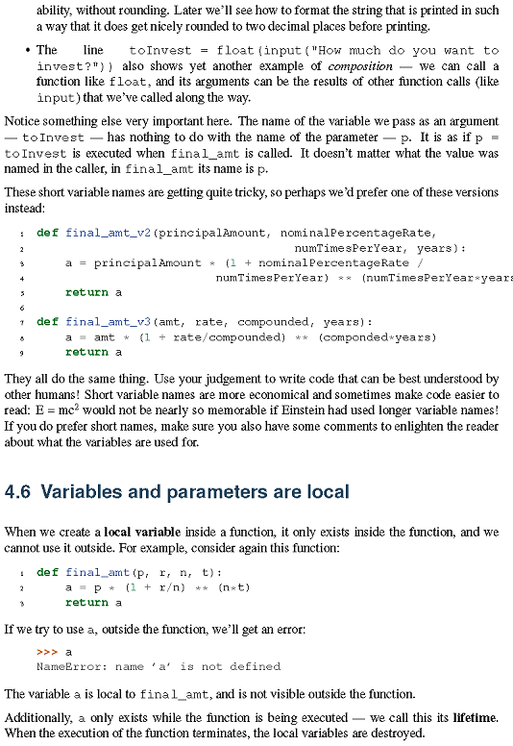

Slide 20
def final_amt_v2(principalAmount, nominalPercentageRate,
numTimesPerYear, years):
a = principalAmount * (1 + nominalPercentageRate /
numTimesPerYear) ** (numTimesPerYear*years)
return a
def final_amt_v3(amt, rate, compounded, years):
a = amt * (1 + rate/compounded) ** (componded*years)
return a
def final_amt(p, r, n, t):
a = p * (1 + r/n) ** (n*t)
return a
>>> a
NameError: name ’a’ is not defined

Slide 21
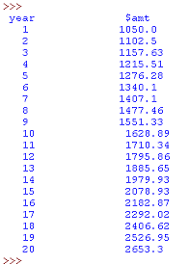
******************************************
WS ch4_6
Choose p,r,n = 1000,0.05,1. Use final_amt(p, r, n, t) with a for loop to print out a table showing the final amount for the 1st 20 years. Look up and use the round function to print out 2 decmal places.
******************************************

Slide 22
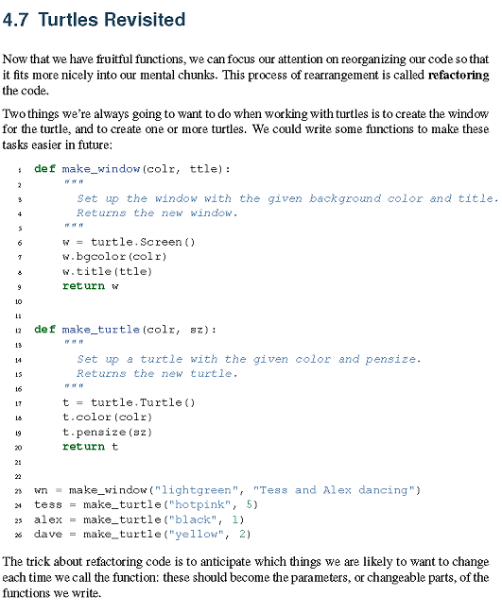

Slide 23
import turtle
def make_window(colr, ttle):
'''Set up the window with the given background color and title.
Returns the new window. '''
w = turtle.Screen()
w.bgcolor(colr)
w.title(ttle)
return w
def make_turtle(colr, sz):
'''
Set up a turtle with the given color and pensize.
Returns the new turtle.
'''
t = turtle.Turtle()
t.color(colr)
t.pensize(sz)
return t
wn = make_window("lightgreen", "Tess and Alex dancing")
tess = make_turtle("hotpink", 5)
alex = make_turtle("black", 1)
dave = make_turtle("yellow", 2)
tess.fd(100)
alex.rt(60)
alex.fd(200)
dave.rt(120)
dave.fd(300)

Slide 24

**********************************************
WS ch4_7
Use turtle_refactor(colr,ttle) & draw_rectangle(t,W,H) to have
Tess make a 100 x 50 rectangle
Alex make a 150 x 200 rectangle at 45 deg wrt horizontal
Dave make a 200 x 250 rectangle at 70 deg wrt horizontal
***********************************************

Slide 25
**********************************************
WS ch4_8
***********************************************
Write a function, trngl_perim(x1,y1,x2,y2,x3,y3), which takes the coordinates of the 3 vertices of a triangle as parameters and which returns the perimeter of the triangle. Write a helper function, distance(x1,y1,x2,y2), which returns the distance between 2 points, which will be in the definition of trngl_perim(x1,y1,x2,y2,x3,y3). Check that both functions are working correctly.
Find the perimeter of the triangle whose vertices are
(1,2),(3,4),(5,6).

Slide 26
**********************************************
WS ch4_9
The number, e, Euler’s number, is an irrational number which has the value of 2.718281828459045 to that many decimals places. It is just as important as the number pi. [You can access the value of e from the math module as math.e.]
A formula for e^{x} is the infinite sum
e^{x} = 1 + x + x²/2! + x³/4! + …. + x^{n}/n! + ….
Write a function, e_to_the_x_series(x,n), which returns n terms of the above series:
1 + x + x²/2! + x³/4! + …. + x^{n}/n!
Use factorial(n) as a helper function in the definition of e_to_the_x_series(x,n).
Print out a table of e^x for x from 0 to 5 in steps of .5. The table should have 3 columns (don’t worry too much for now about making things line up):
>>>
x e^x series e^x using
w 10 terms value of e
------- --------- ---------
0 1.0 1.0
0.5 1.6487 1.6487
1.0 2.7183 2.7183
1.5 4.4817 4.4817
2.0 7.3887 7.3891
2.5 12.1791 12.1825
3.0 20.0634 20.0855
3.5 33.0057 33.1155
4.0 54.1541 54.5982
4.5 88.4785 90.0171
5.0 143.6895 148.4132
>>>

Slide 27

WS ch 4-10
This example is about helper functions, not conditionals.
Write code to produce the following turtle output. Use appropriate helper functions.

Slide 28
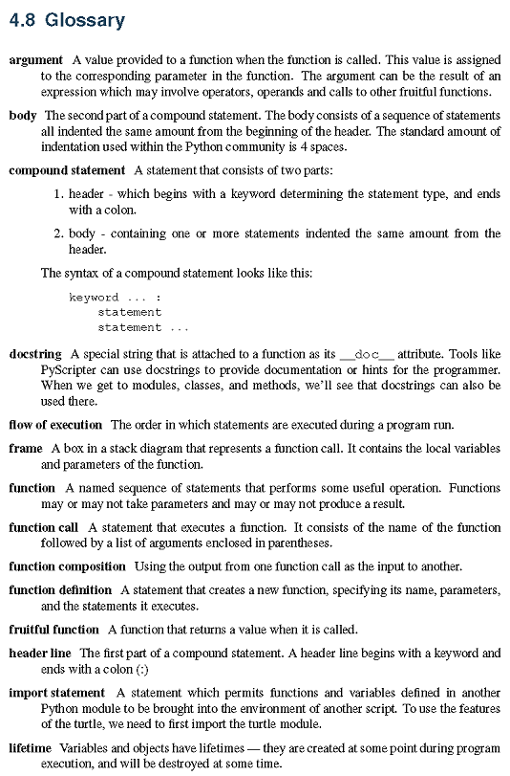

Slide 29
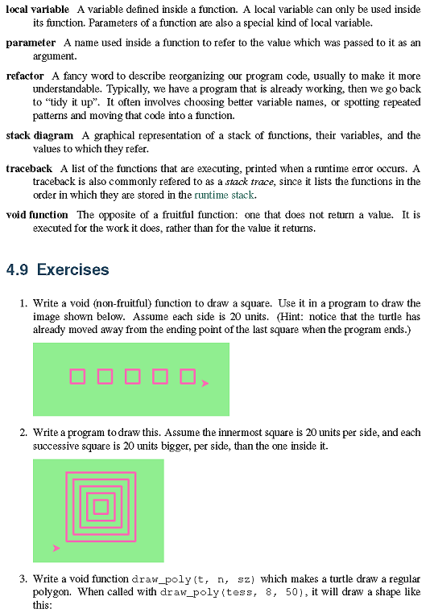

Slide 30
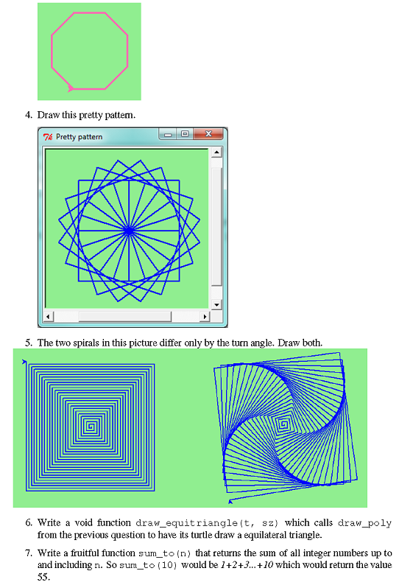

Slide 31
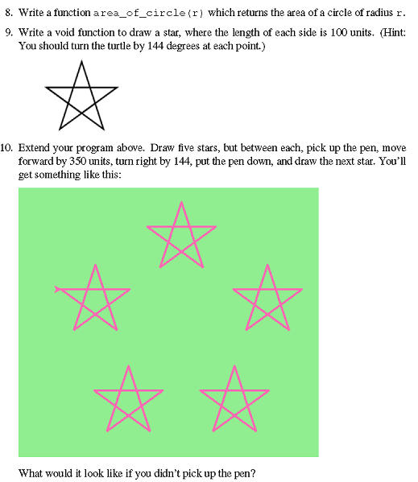

Slide 32
HW: 1,2,4,7
Youtube: 5

